Slide 1
People Detection and counting in a crowded area
205229103
Arzoo Sah

Slide 2
CROWD COUNTING
Crowd Counting is a technique to count or estimate the number of people in an image
count the number of people in certain parts of an image and then extrapolate to come up with an estimate. More commonly, we have had to rely on crude metrics to estimate this number for decades.
While we don’t yet have algorithms that can give us the EXACT number, most computer vision techniques can produce impressively precise estimates.

Slide 3
Why is Crowd Counting Useful ?
A company just finished hosting a huge data science conference. Plenty of different sessions took place during the event.
You are asked to analyze and estimate the number of people who attended each session. This will help your team understand what kind of sessions attracted the biggest crowds (and which ones failed in that regard).
There were hundreds of people at the event – counting them manually will take days! That’s where your data scientist skills kick in. You managed to get photos of the crowd from each session and build a computer vision model to do the rest!
There are plenty of other scenarios where crowd counting algorithms are changing the way industries work:
Counting the number of people attending a sporting event
Estimating how many people attended an inauguration or a march (political rallies, perhaps)
Monitoring of high-traffic areas
Helping with staffing allocation and resource allotment

Slide 4
Different Computer Vision Techniques for Crowd Counting
Detection-based methods
use a moving window-like detector to identify people in an image and count how many there are. The methods used for detection require well trained classifiers that can extract low-level features. Although these methods work well for detecting faces, they do not perform well on crowded images as most of the target objects are not clearly visible.
Regression-based methods
We were unable to extract low level features using the above approach. Regression-based methods come up trumps here. We first crop patches from the image and then, for each patch, extract the low level features.

Slide 5
3. Density estimation – based methods We first create a density map for the objects. Then, the algorithm learn a linear mapping between the extracted features and their object density maps. We can also use random forest regression to learn non-linear mapping 4. CNN-based methods build an end-to-end regression method using CNNs. This takes the entire image as input and directly generates the crowd count. CNNs work really well with regression or classification tasks, and they have also proved their worth in generating density maps. CSRNet, a technique we will implement in this project, deploys a deeper CNN for capturing high-level features and generating high-quality density maps without expanding the network complexity.

Slide 6
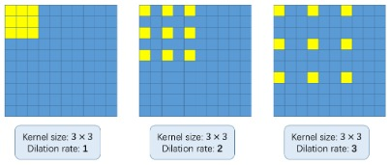
METHODOLOGY CSRNet uses VGG-16 as the front end because of its strong transfer learning ability. The output size from VGG is ⅛th of the original input size. CSRNet also uses dilated convolutional layers in the back end. The basic concept of using dilated convolutions is to enlarge the kernel without increasing the parameters. So, if the dilation rate is 1, we take the kernel and convolve it on the entire image. Whereas, if we increase the dilation rate to 2, the kernel extends as shown in the above image (follow the labels below each image). It can be an alternative to pooling layers.

Slide 7

Suppose we have an input x(m,n), a filter w(i,j), and the dilation rate r. The output y(m,n) will be: We can generalize this equation using a (k*k) kernel with a dilation rate r. The kernel enlarges to: ([k + (k-1)*(r-1)] * [k + (k-1)*(r-1)]) So the ground truth has been generated for each image. Each person’s head in a given image is blurred using a Gaussian kernel. All the images are cropped into 9 patches, and the size of each patch is ¼th of the original size of the image. The first 4 patches are divided into 4 quarters and the other 5 patches are randomly cropped. Finally, the mirror of each patch is taken to double the training set. ** Gaussian kernel - To reduce image noise and reduce detail ** https://colab.research.google.com/drive/1dNmIYNZiVJYCyVp2s1476ldUXKn2A5ho?authuser=1#scrollTo=CfnX0nKgQazI

Slide 8
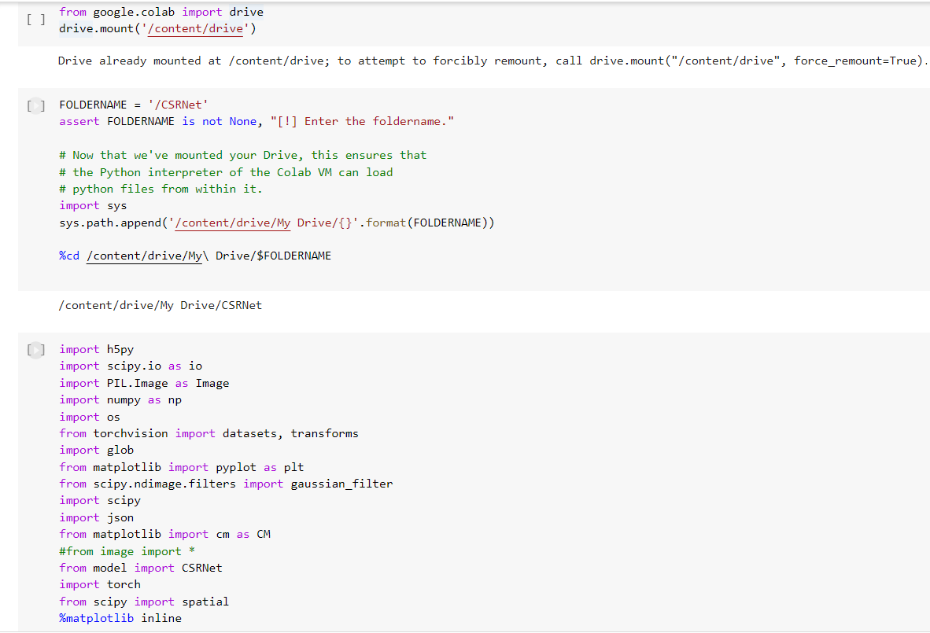
Requirement h5py Pillow scipy numpy os glob matplotlib torch

Slide 9
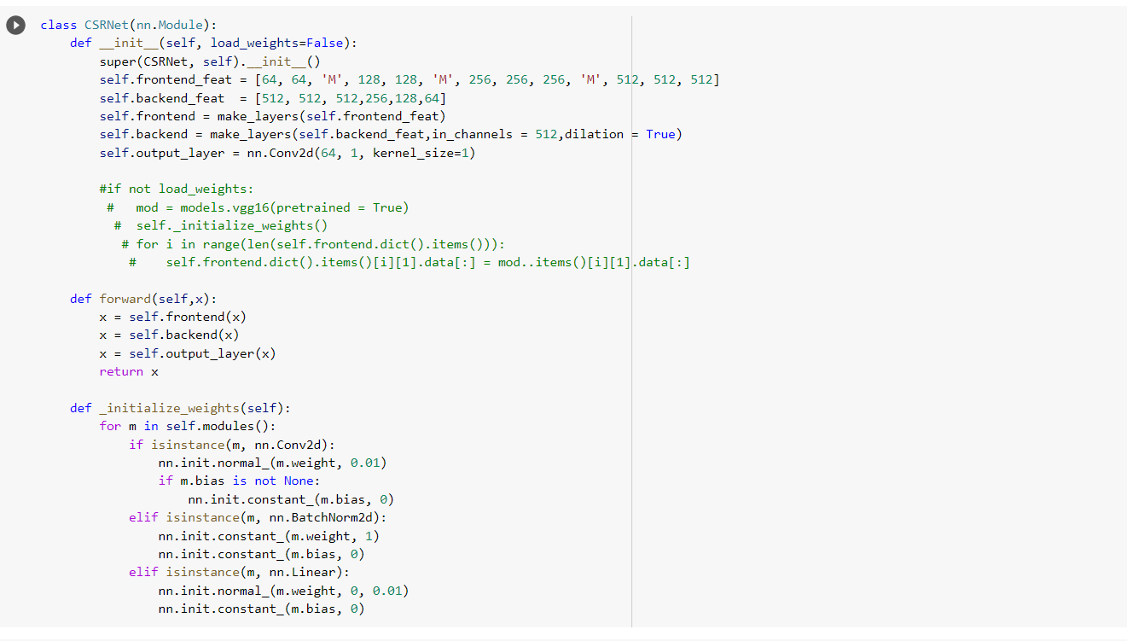
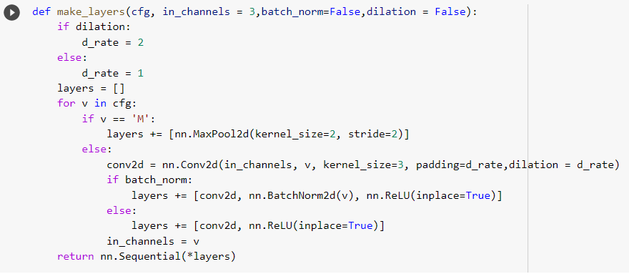
# creating CSRNet model

Slide 10
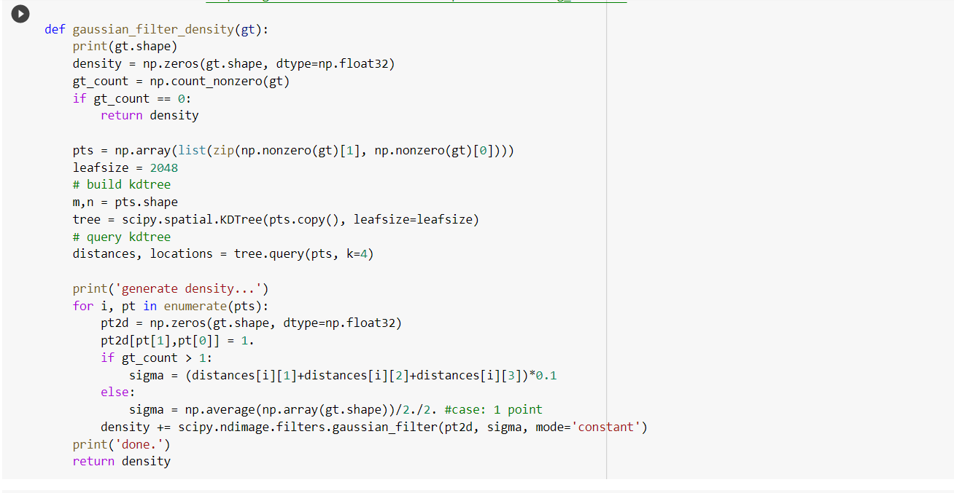
# creating gaussian_filter_density function

Slide 11
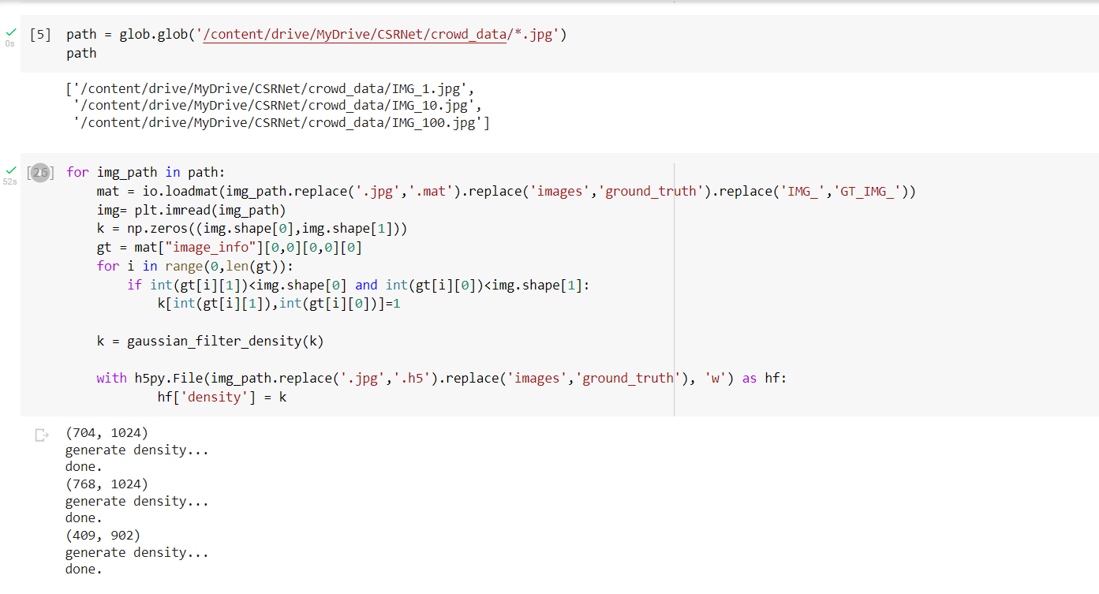
# creating create_density_map function

Slide 12
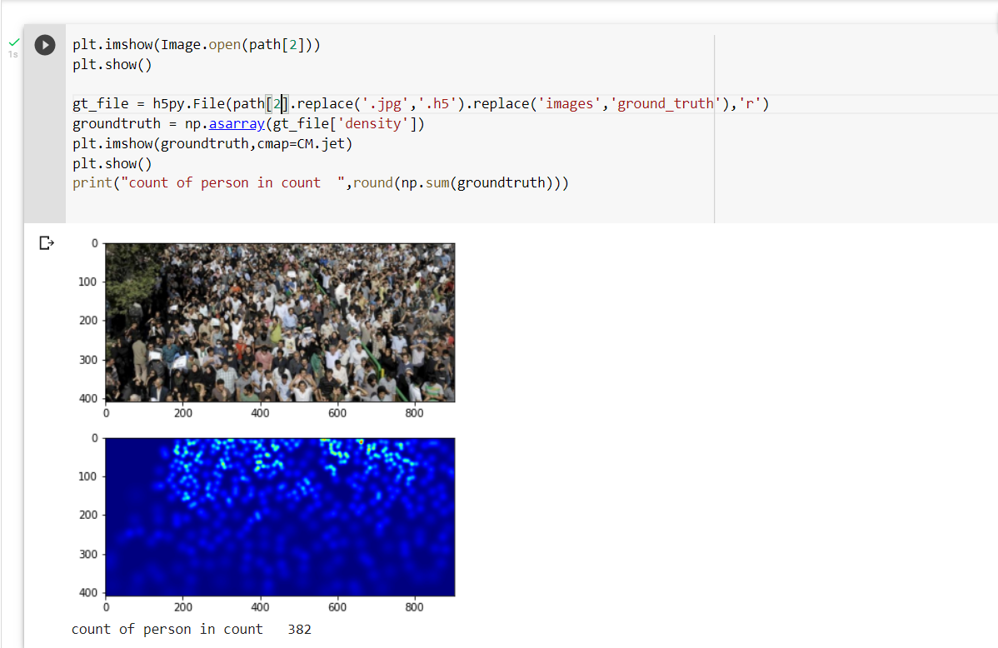
OUTPUT

Slide 13
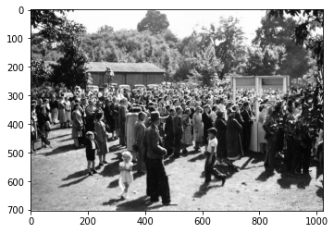
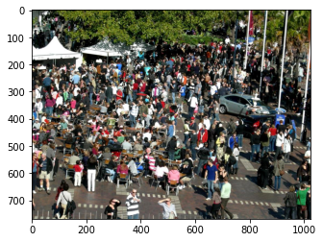
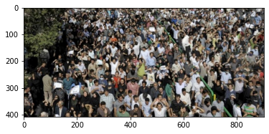
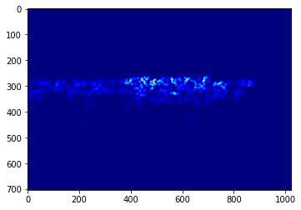
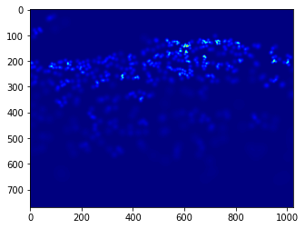
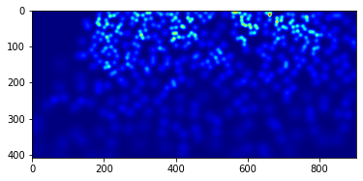
Count:497
Count:172
Count: 382

Slide 14
CONCLUSION In this project , I have created a model involving CNN concept to count the number of person in a crowd By using a dataset available in Kaggale. Able to estimate the count of person in a huge crowd

Slide 15
REFERENCES kaggale Analytics Vidhya Medium.com TowardsDataScience Github

Slide 16
You-tube Link https://youtu.be/QtsQZLkZzDM

Slide 17
THANK YOU

